Slide 1

By Nabanit Roy
End-to-End Data Science Project
Building a Production-Ready Machine Learning Pipeline with MLflow & DagsHub
DATA SCIENCE | MACHINE LEARNING | MLOPS

Slide 2


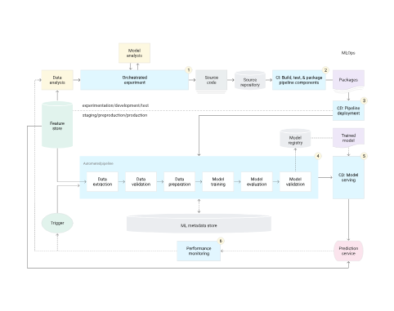

📂 Business Problem
Modern Machine Learning projects often fail due to structural complexity:
Poor Reproducibility: Difficult to replicate environment states and dataset splits.
Untracked Experiments: Metric changes and parameters get lost in Jupyter notebooks.
Unorganized Pipelines: Monolithic scripts instead of clean modular functions.

Slide 3



🛠️ Technologies Used
Core ML Stack
MLOps Tools
Workspace
Python
MLflow Tracking
VS Code IDE
Pandas
MLflow Registry
Jupyter Notebooks
NumPy
DagsHub Remote
Conda Environments
Scikit-Learn
Git / GitHub
Bash Scripting

Slide 4
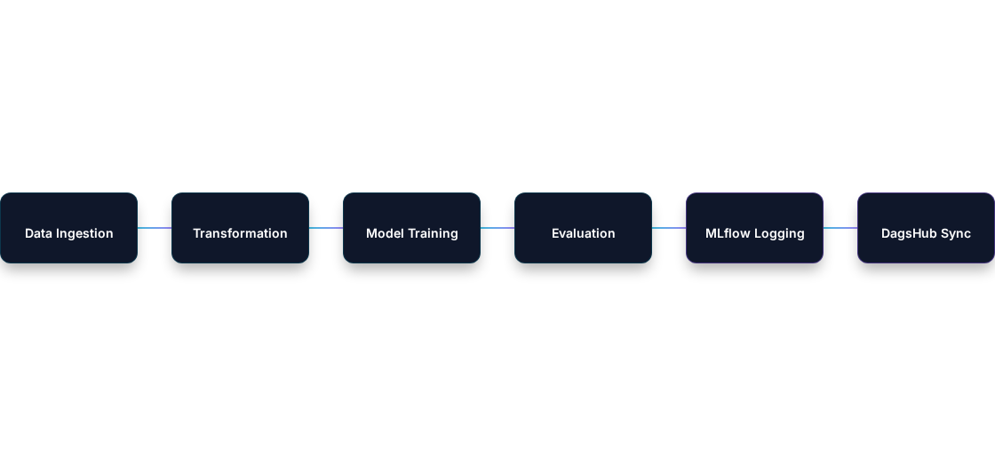
⚙️ Project Architecture
The workflow is structured into a clean pipeline of decoupled, independent scripts:
Each component outputs standardized logs and metadata artifacts dynamically.

Slide 5






🚀 Key Features Implemented
Data Ingestion Pipeline
Data Preprocessing
Feature Engineering
Modular Model Training
Robust Evaluation Metric Logs
Central Exception Handling
MLflow Experiment Runs
DagsHub Cloud Storage
Modular File Structure

Slide 6
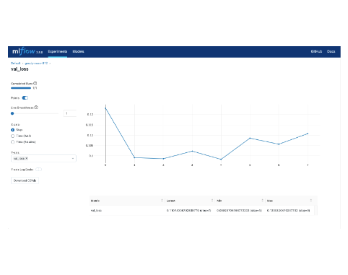
📈 MLflow Experiment Tracking
Integrating MLflow allowed exact tracking across all active runs:
Run Parameters: Auto-logs learning rates, alpha values, and network architectures.
Metric Visualizations: Compares R², RMSE, and accuracy indexes on continuous metrics graphs.
Artifact Storage: Directly stores pickle objects (.pkl) and model binaries.

Slide 7
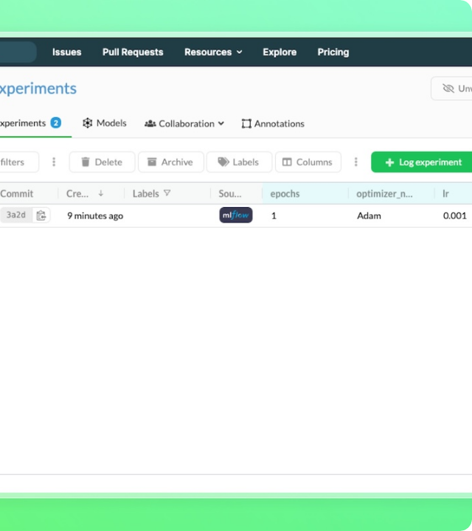
☁️ DagsHub Integration
Remote ML repository sync without local resource blockages.
Hosted MLflow tracking server natively.
Unified space for shared team logging.
Completely reproducible code, data, and models.

Slide 8


🧠 Skills Demonstrated
Data Science
ML Engineering
MLOps
Software Eng.
▪ Cleaning
▪ Training
▪ MLflow
▪ Modularity
▪ Transforming
▪ Regression
▪ DagsHub
▪ Logging
▪ Feature Eng.
▪ Validation
▪ Tracking
▪ Exceptions

Slide 9
🎯 Key Project Learnings
Production Pipeline Structure: Learned how real-world ML pipelines are structured as decoupled scripts rather than bloated notebooks.
Rigorous Tracking Value: Experienced firsthand how experiment tracking dramatically reduces time when comparing multi-model performance.
True Reproducibility: Gained strong practices on linking Git code versioning with dataset releases.
Clean Coding Standard: Strengthened knowledge of logging, customized error messages, and robust exception handler classes.

Slide 10
Thank You 🚀
Let's collaborate on building the future of robust ML platforms!
📂 Repository 👤 GitHub Profile
OPEN TO OPPORTUNITIES IN
Data Science
Machine Learning
Data Analytics
MLOps

Slide 11



Image Sources
https://docs.cloud.google.com/static/architecture/images/mlops-continuous-delivery-and-automation-pipelines-in-machine-learning-4-ml-automation-ci-cd.svg
Source: docs.cloud.google.com
https://mlflow.org/docs/latest/assets/images/tracking-metrics-ui-temp-ffc0da57b388076730e20207dbd7f9c4.png
Source: mlflow.org
https://dagshub.com/docs/use_cases/assets/track_ml_experiments/experiments_dagshub.jpeg
Source: dagshub.com

